Slide 1
A Peer Support Approach to Program Evaluation Research
Tanya Shute, Associate Professor, School of Social Work
Everly Javier, Researcher & Research Coordinator, Krasman Centre
Strength in Equity and Diversity: Amplifying Voices, Ensuring Sustainability, and Building Stronger Peer Support Futures
Joint conference, PeerWorks and Peer Support Canada
March 26/27 2025
Notes:
Thank researchers at LU for making it through, and to the Research Office, Dr. Tammy Eger, and the folks at the REB for getting us through this…

Slide 2
Purpose/Agenda
First, a note about the language we use: CSIs and PSOs/CSSOs
Review of some of the academic evidence for CSIs/PSOs and for peer support with people who can be said to experience mental distress/extremes or who have experience with the mental health system
Review some of the principles/values of peer support in the psychiatric consumer/survivor sector
Problematic/speak to the ”peer” in mainstream participatory research
Begin to articulate what a peer-led peer support approach to program evaluation/community-based research would look like as the best method to achieve the best findings for research that matters to us

Slide 3
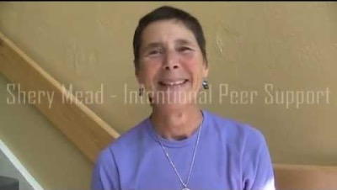
What Peer Support means here – primarily in the X/PC/S/Mad/Mad Pride/Critical Disability Space
Primarily mental distress/mental health system experience but also significant intersection with substance use and homelessness (as the boundaries are artificial in real world)
Intentional – this is a relationship, not a service or intervention

Slide 4
Grounding the work of CSIs/PSOs/CSSOs in E/PC/S/Mad movement (Canada and elsewhere)
There has always been resistance, but most literature situates deinstitutionalization as the catalyst of the movement
Consumer/Survivor-run/operated programs grew out of the successes of the informal mutual aid/self-help movement that developed out of necessity in Ontario (and worldwide) after the ill-planned deinstitutionalization of masses of people into communities where a community mental health sector was yet to be developed
These programs, eventually some of them becoming organizations, maintained the collective care of mutual aid/self-help ethos of the movement (*caution: debate as to how liberatory they could remain if they accepted government funding, rendering them part of the mental health system some wanted to reform, but others needed to abolish)

Slide 5
Peer Support (and our orgs!) is Anchored in Social Movement Values
p. 16 Drift from Peer Support Values and Standards: A Position Statement and Call for Action
The five core movement values

Slide 6
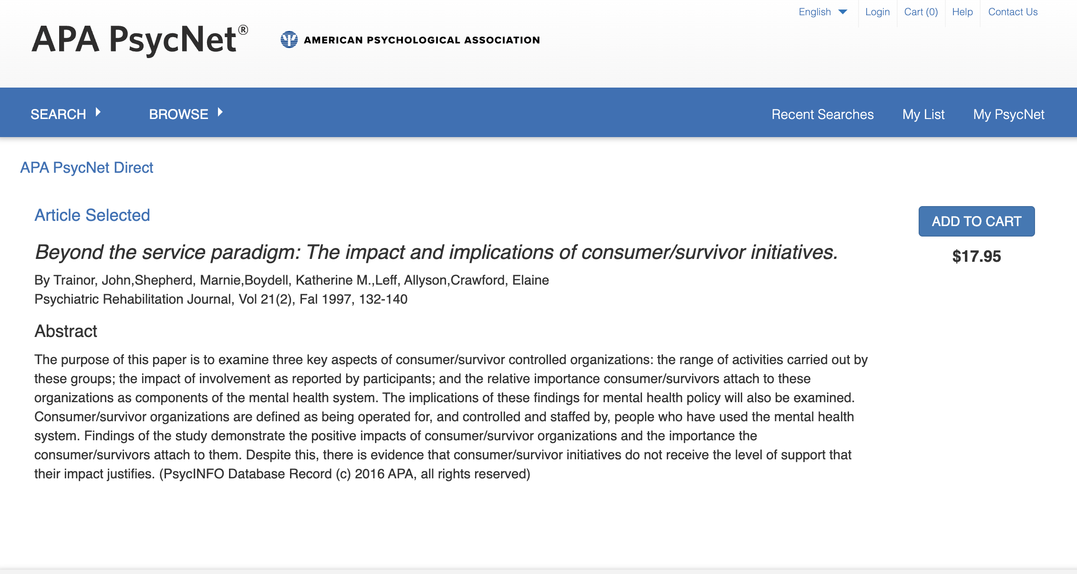
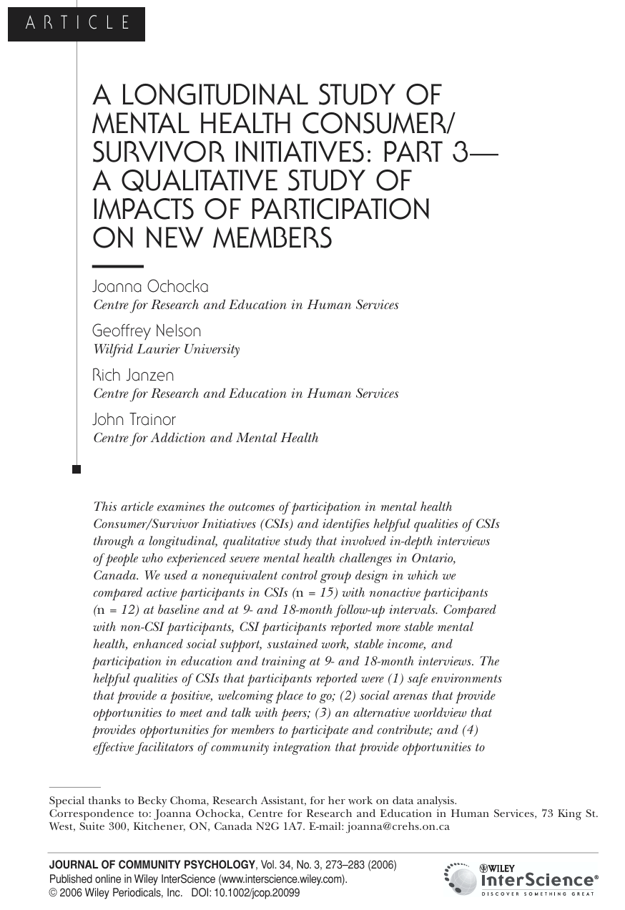
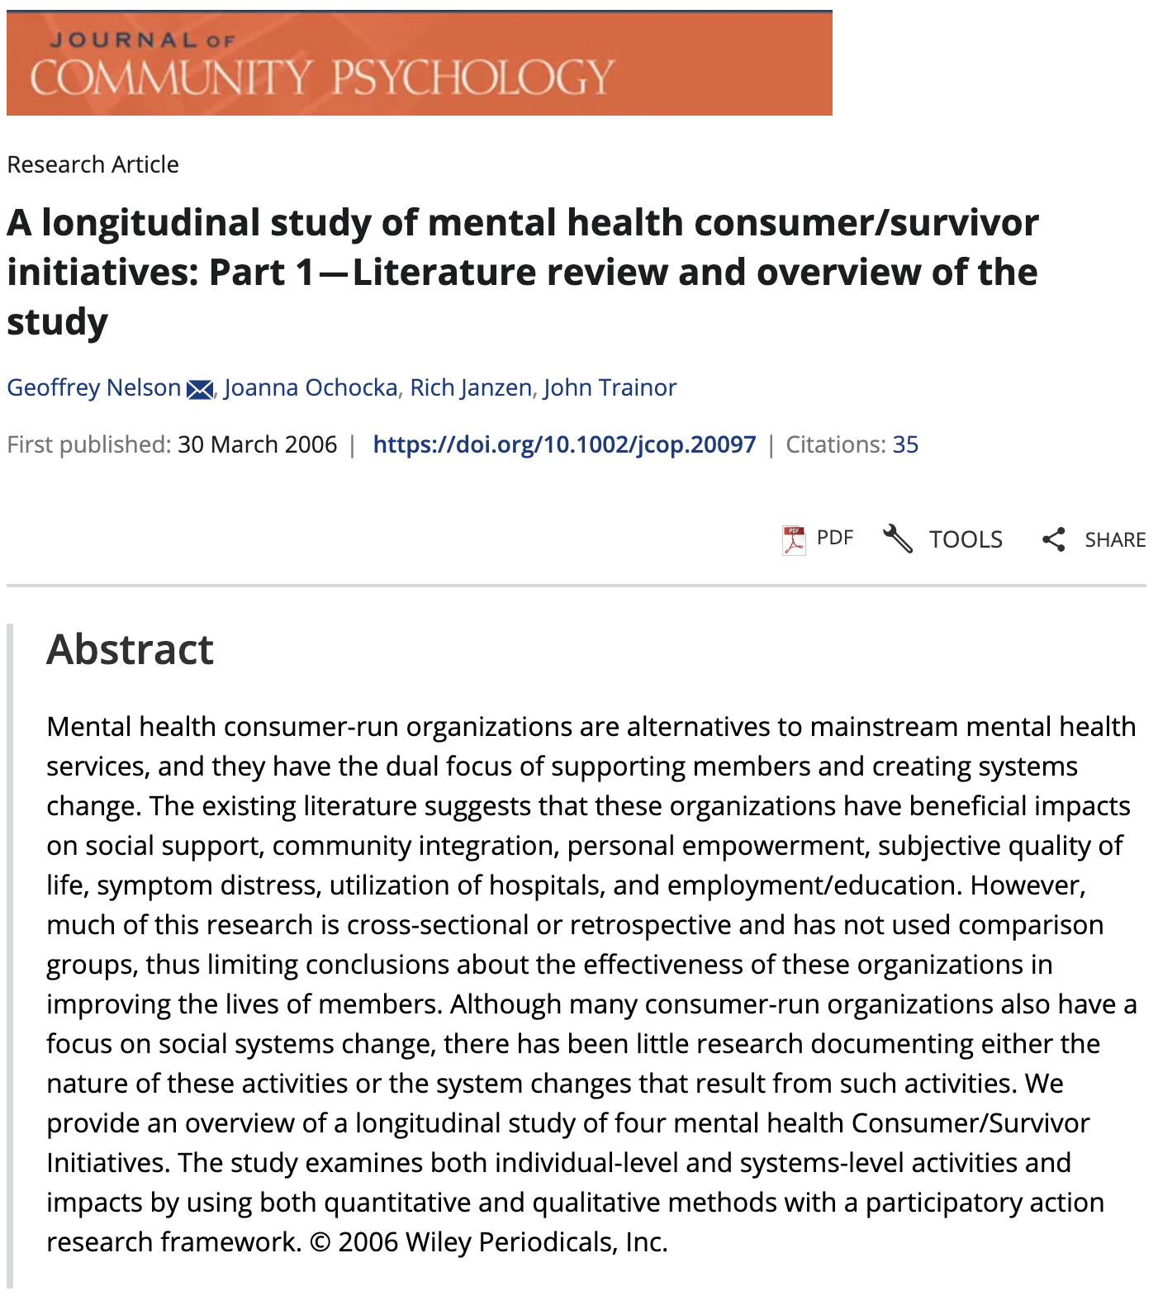
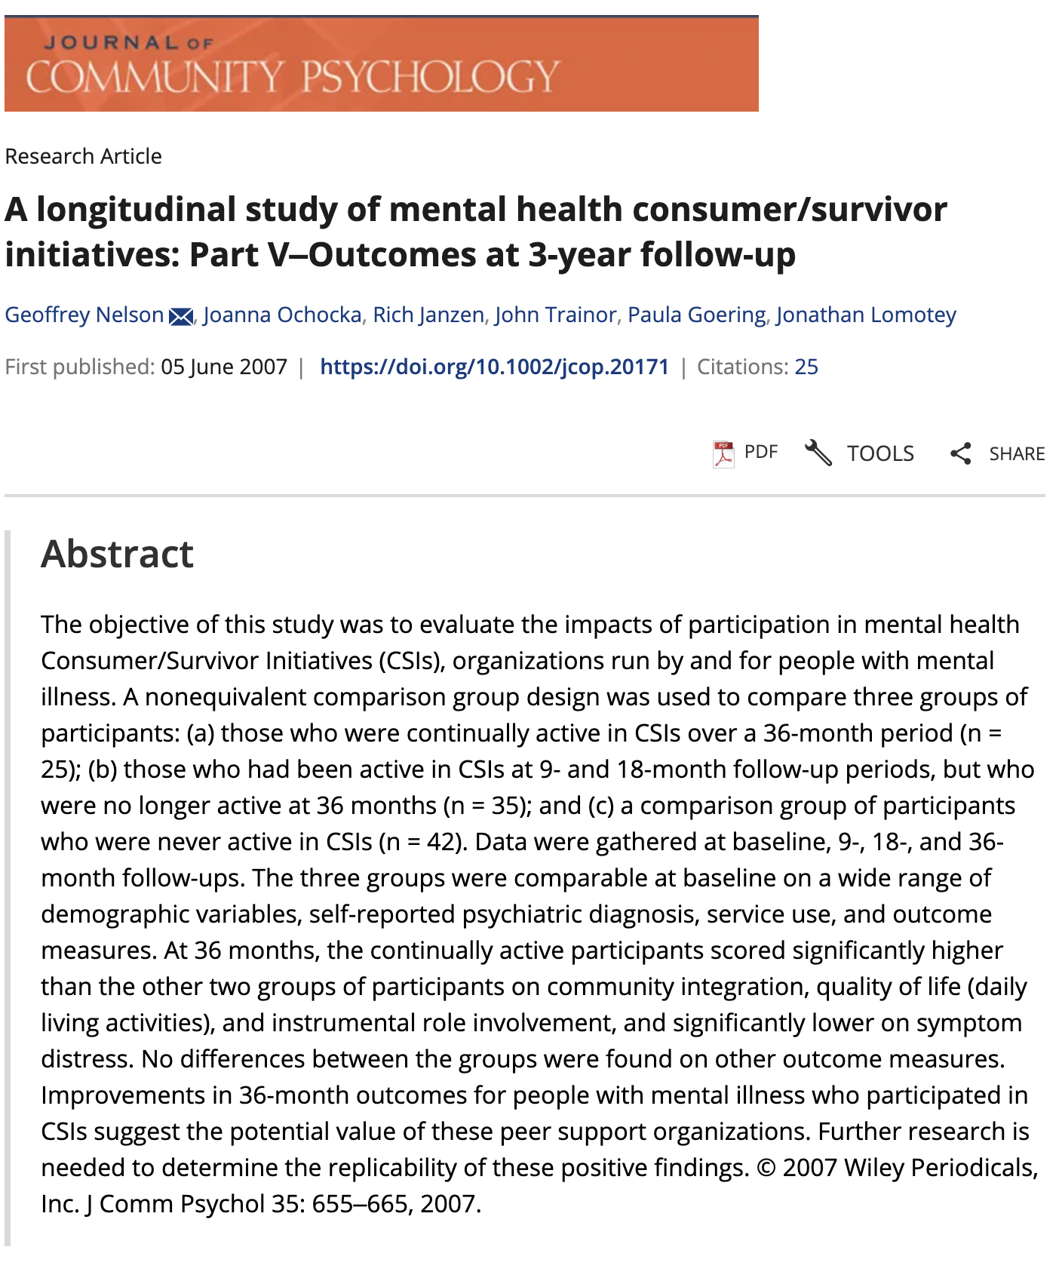

Slide 7
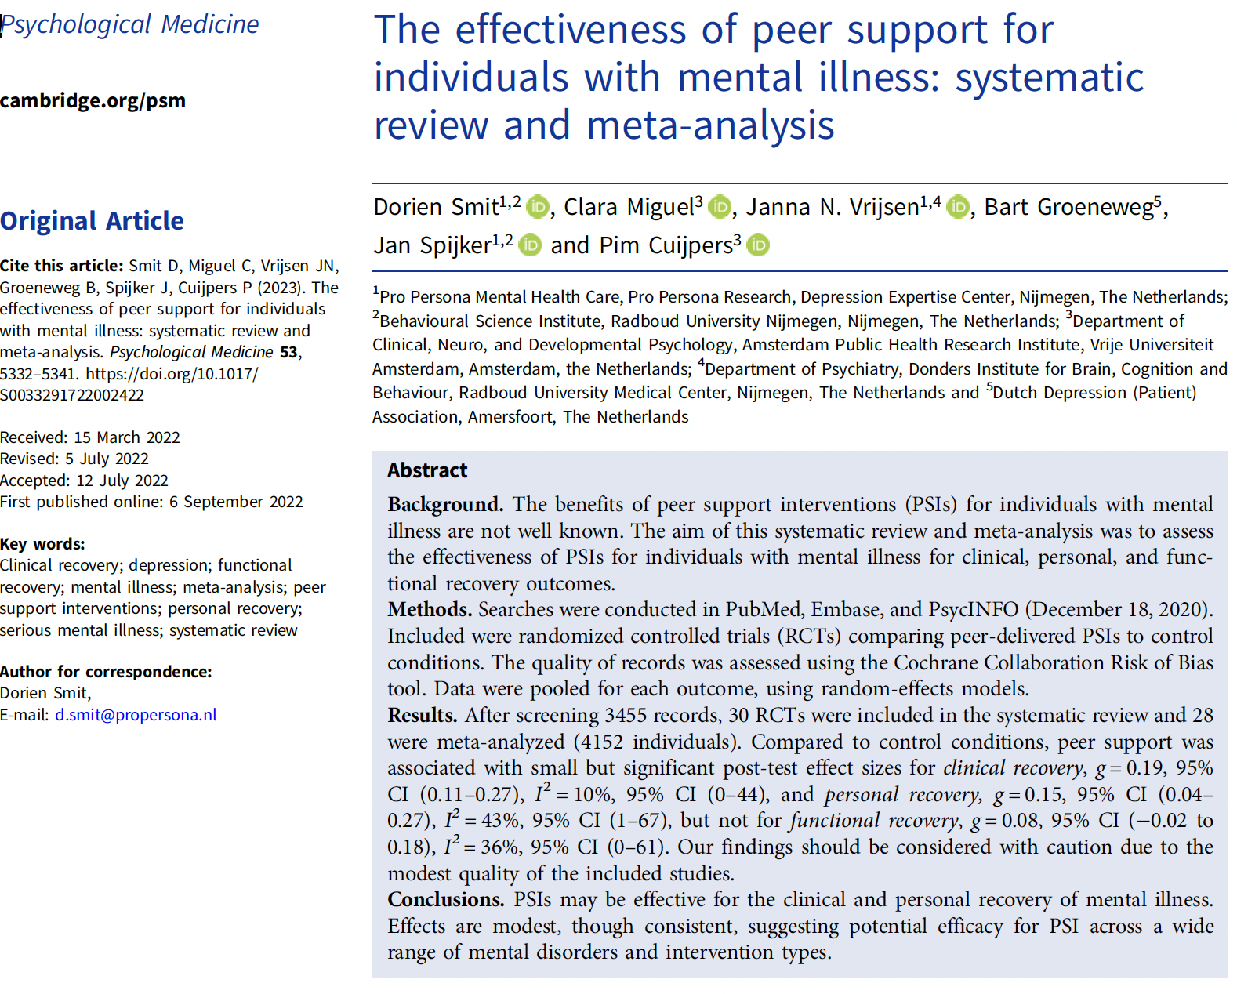

Slide 8
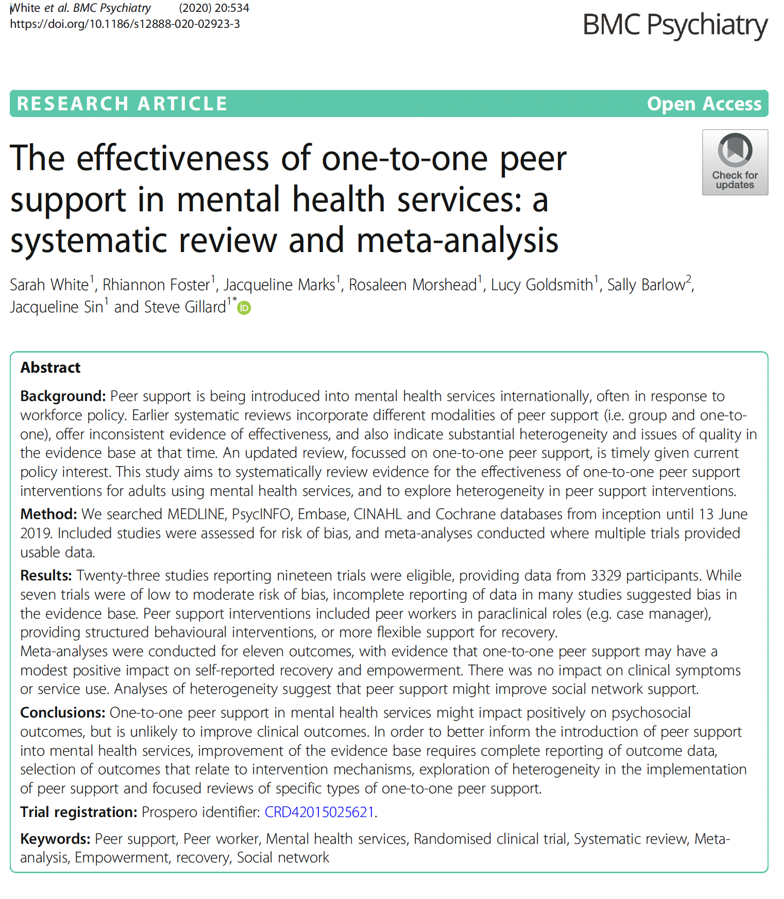
Research about peer support has become more prolific, but limited value for peer-run organizations

Slide 9
Current state of “evidence”
Because of the effectiveness, and popularity in the mainstream, of peer support in the mental health system – the focus of research has tended to be on peer support itself (usually as a service)
including RCTs, meta-analyses and systematic reviews
(often confusing sectors, intervention types, and not-so-far looking at settings)
often looking at “outcomes/symptoms” but not always looked at other aspects of recovery that are meaningful to us (e.g. hope)
And peer-led spaces research has fallen off, especially in Canada

Slide 10
Gillard 2019: A strong argument can be made, of course, that peer support might be better situated outside of the constraining culture of formal mental health services [and that as researchers we might therefore better focus on evaluating those endeavours].
it is certainly the case that peer-reviewed research of this more independent peer support is relatively lacking (Pistrang, Barker, &Humphreys, 2008) (as cited in Gillard, 2019, p.342

Slide 11
the case for research by us, for us – reflecting our core values and principles of self-determination
The empowered and emancipatory value-base of these organizations holds significant implications for research with and about them.
Noted, Participatory Action Research approaches reflect the values of participation and self-determination, or the “nothing about us without us” philosophy of the movement and the development of CSI/PSOs.
Historically, MHSH initiatives have been leery of…reliance on external professional experts” (Nelson et al., 2010, p.51) based on a previous history of disempowerment at the hands of mental health and system experts, as well as being sensitive to the traditional power relations of expert-client, preferring relationships to be more egalitarian. “The regrettable history of disrespect, even abuse, in mental health research still lingers” (Whitaker, 2001 as cited in Nelson et al., 2010)

Slide 12
How evaluation/research needs to show up in CSIs/peer-led settings
When approaching research with CSIs, there is a strong rationale for using participatory action research methods and evaluation (Nelson, Janzen, Ochocka, & Trainor, 2010), as an antidote to the passive patient/research subject position constructed for people with serious mental health challenges in the traditional positivist approaches to mental health research.
PAR approaches typically involve enhanced levels of reciprocity between the researcher and participants and seeks to maximize their participation in all aspects of the research, including study design
The values of PAR honour the consumer/survivor movement and initiatives specifically, in that not only is the process collaborative and democratic, but the goal of research is to inform or inspire social change
PAR honours and focuses on legitimizing experiential knowledge and qualitative methods based on story and dialogue, something aligned well with the consumer/survivor movement and its social change efforts. The transformational paradigm of PAR approaches also aligns with the activism of the movement.
This aligns with the broader trend in program evaluations for peer-run mental health organizations, recognizing the importance of capturing both numerical data and rich narratives to comprehensively assess their impact (Siantz & Strow, 2019).

Slide 13
Going beyond ”involving peer researchers” in PAR
We know the value of genuine involvement, but it is a continuum and we know lots of projects called themselves participatory but at the consultation end of the continuum.
By actively involving peers in the research process, the study not only enhances the validity of findings but also contributes to the empowerment and capacity building of individuals with lived experience (Halsall et al., 2021).
Sangill et al.’s 2019 scoping review about service user experiences in research – limits to genuine participation

Slide 14
And now…
Introducing Everly Javier – researcher and research coordinator I am lucky to get to work with…
Context: Community-Based Research/PAR education/training session

Slide 15


Slide 16
How we reflected the movement’s values/principles in the evaluation project:
1 - Identification with one another with shared experience, embodying relational values of:
authenticity
mutuality
reciprocity
empathy
open-mindedness
acceptance
community
experiential knowledges

Slide 17
2. Shared power in trusting relationships, for example:
- honesty
- transparency
- voluntariness
- learning together
- respect
rather than exercising power over others

Slide 18
3. Strengths-focused understanding of mental health and addiction concerns, for example:
Hope
Recovery
Empowerment
Wellness
Lifelong learning
Personal growth
holistic person-driven support rather than a focus on illness, deficit, pathology

Slide 19
4. Independent voice and choice in the mental health and addiction system, for example:
Self-determination
autonomous participation in decision-making
peer-led initiatives that differ from dominant medical treatment models

Slide 20
5. Collective well-being through action and change to improve social conditions
as peers spend time together in peer communities, we raise our awareness about the societal stigma and discrimination shaping our life possibilities, gain confidence and capacity to advocate for human rights and social justice, and seek liberation and inclusion

Slide 21
References
If I don’t get to this -- maybe email me and I can send them when I get them done? Tg_shute@laurentian.ca
Any suggestions, recommendations for feedback is eagerly accepted – same email!

